Slide 1
Project Tile –
Domain of Project –
Student Name | Roll No | Email ID | Mobile number [WhatsApp]
Recommended font style and size:
Font Style: Arial
Font Size (Heading): 28
Font Size (Content): 20

Slide 2
Problem Statement -

Slide 3
Proposed Solution -

Slide 4
Technology Used
Mention what technology used. Whether LangChain/ Langflow
RAG based/ Single or Multi agent
Vector Database if used.

Slide 5
Langflow component Used -
1) Chat Input – Interface where users enter their queries, preferences, or meal details (text/voice/image).
2) Name of model - Granite-4.0-8B-Instruct → Fast, efficient for real-time diet recommendations
4) Chat output -Displays AI-generated responses such as diet plans, nutritional analysis, and health suggestions.
5) File component - Stores and retrieves user data, meal logs, and nutritional datasets for analysis and tracking.
6) Add name of any other component used.

Slide 6
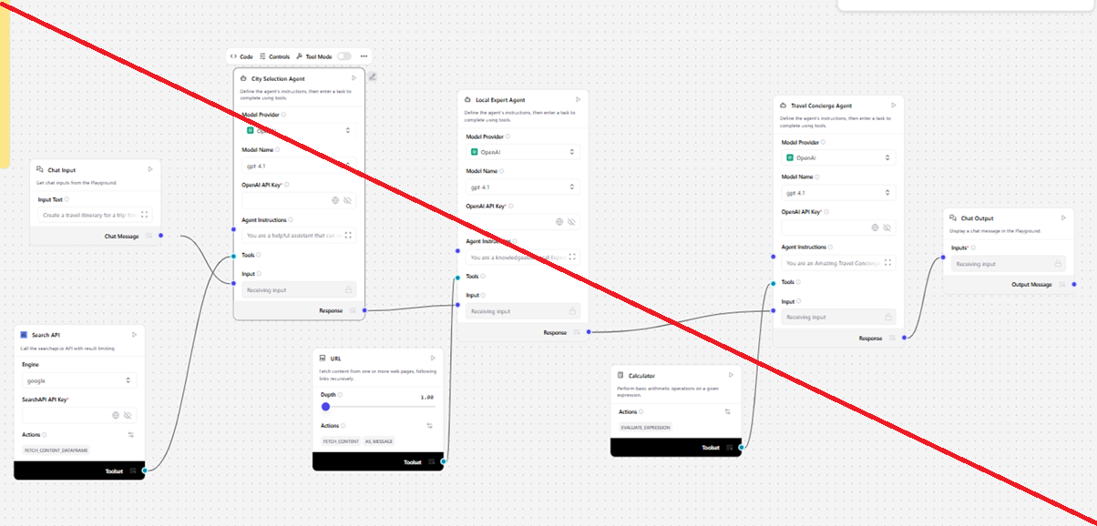
Langflow workflow -

Slide 7
Future Scope
·
·
·

Slide 8
Reference / GitHub Link
· Please create public github repository (Enable Add README button while creating repository) with format –
Please test and Paste the working Github URL –
·
·
·

Slide 9


